Slide 1
Human-machine interaction through gesture recognition
BSc Thesis Presentation
By Dmitrii Cucleschin

Slide 2
Motivation
Communicating underwater can be complicated
Between the divers
Between the divers and their devices
Between the divers and the ground crew
“Traditional” input methods can’t be used
Often, the equipment is bulky and can put diver at risk
Need easier, more natural way to interact with the devices: how about gesture recognition?
Source: http://www.roadproject.it/images/validation_01.jpg
Notes:
Even though diving is a common hobby nowadays, special training is required before you go underwater unsupervised.
It presents its own set of challenges like not enough light, need in oxygen and difference in common patterns.

Slide 3
State of the art
Research on natural interactions with robots shows higher emotional feedback (First picture: Robot Aurora to help children with autism)
Gesture control in appliances (Samsung Smart TV, Xbox + Kinect, Myo armband, Leap Motion)
Chinese-American sign language translator
Handpose: fully articulated hand tracking (Second picture: Screenshot from the announcement)
Source: http://www.aurora-project.com
Source: http://research.microsoft.com/en-us /projects/handpose/

Slide 4
Setup
Kinect v2.0 sensor
Windows 8+
EmguCV (OpenCV for C#)
> 4 GB RAM, USB 3.0 controller
Kinect should be positioned to minimize the noise
Only one user is present, located directly in front of the sensor
View is not obstructed by any object in front of the user
Hand should be extended in front of the body
Avoid fast movement (due to the motion blur)
Source: http://microsoft.com/en-us/kinectforwindows/
Notes:
Why Kinect? Can be swapped easily.

Slide 5
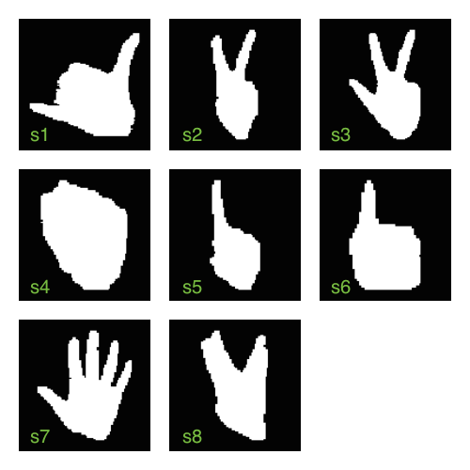
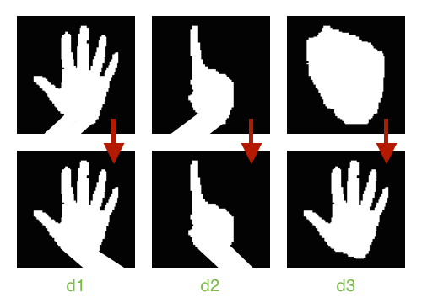
Gesture set
Static:
Dynamic:
Notes:
Show dynamic gestures.

Slide 6
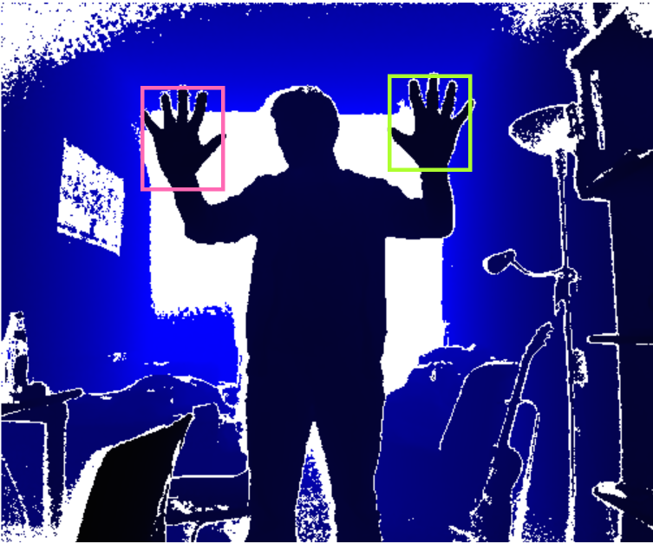
Frame processing
Initialize multi-source frame reader
Get depth and body frames
Save depth frame to a buffer
Extract relevant joint coordinates and convert them to 2D space

Slide 7
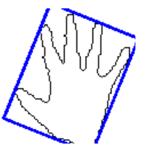

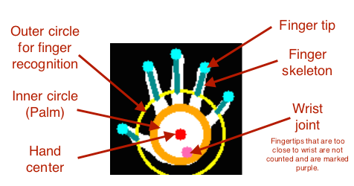
Hand segmentation
Extract relevant region using Flood Fill
Find center point using maximum value of Distance Transform 2D (If more than one, get closest to Kinect’s approximation)
Draw an inner circle with radius r (No more than n/30 black dots)
Draw an outer circle with R = 1.6 * r

Slide 8
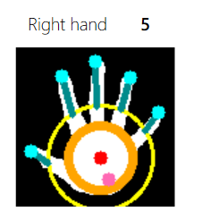
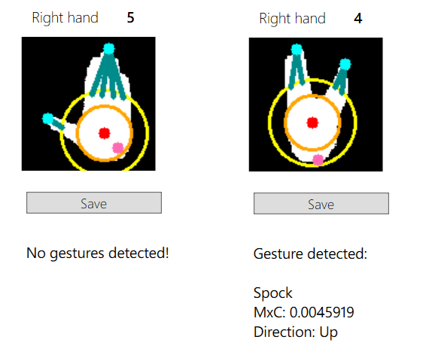
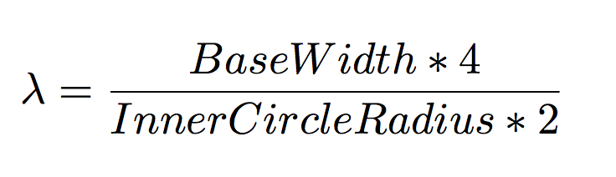
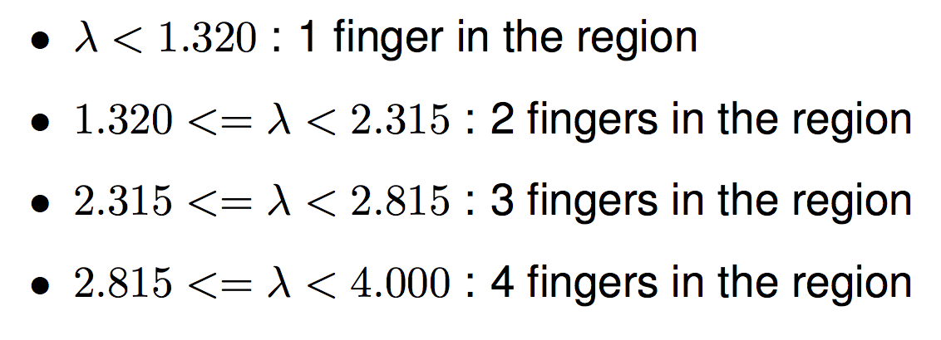
Finger recognition
Analyze values outside of the outer circle
Detect regions from the remaining pixels
Locate the tip and base of every finger
If a region is too wide, classify it as multiple fingers

Slide 9
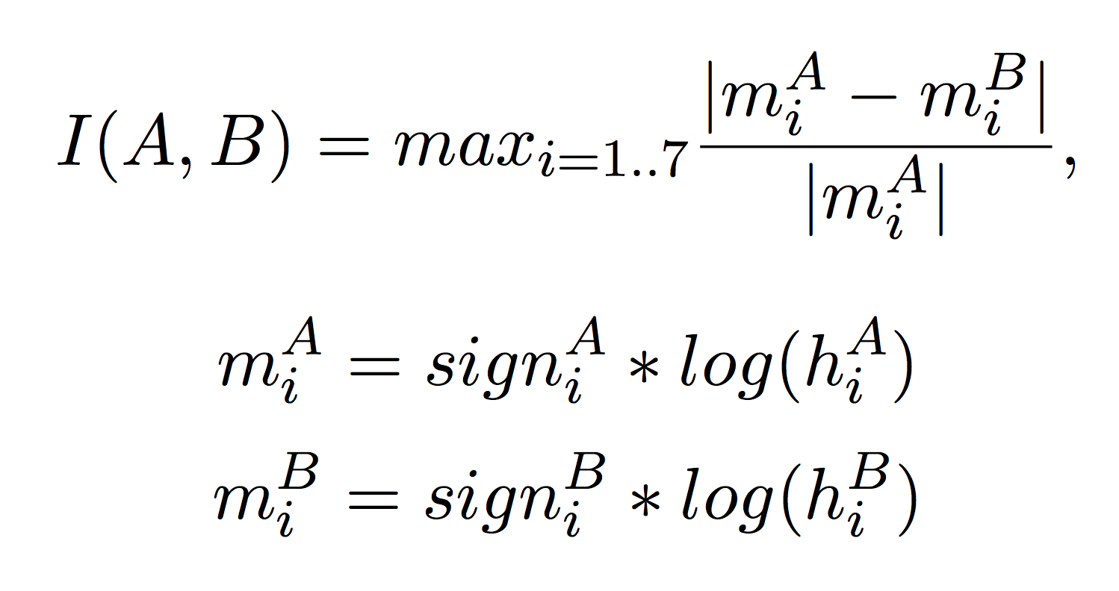
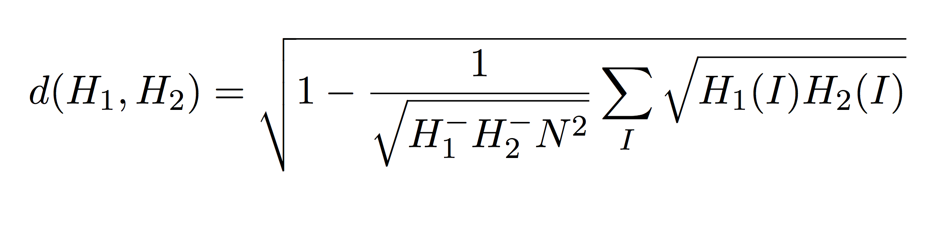
Gesture recognition
Finger number matching
Contour matching using Hu moments
Pair-wise geometric histogram comparison (using Bhattacharyya distance)
Notes:
An image moment is a certain particular weighted average of the image pixels' intensities, or a function of such moments, usually chosen to have some attractive property or interpretation.
Hu invariant set consists of 7 values, based on the image moments, that are rotation, scale and scew (7th) invariant. Contour matching compares the difference between two contour’s moments and checks whether it’s below certain threshold.
A pairwise geometric histogram encodes the probability of geometric co-occurrences between any line and the set of lines defining an object.
To do that, algorithm considers every pair of contour edges and calculates the angle between the edges and the minimum/maximum distances are determined for every pair (looping through all edges). The angle between the edges defines the row of the histogram in which all the bins that correspond to the distance between the calculated minimum and maximum distances are incremented.
Bhattacharyya distance is commonly used to compare difference between two sets of probability distributions (N = number of bins, H1, H2 = histograms).

Slide 10
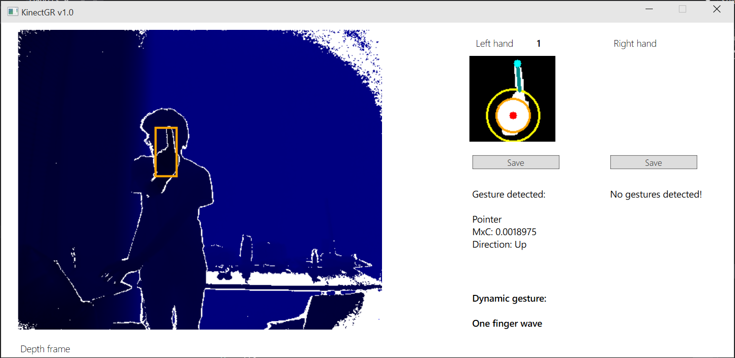
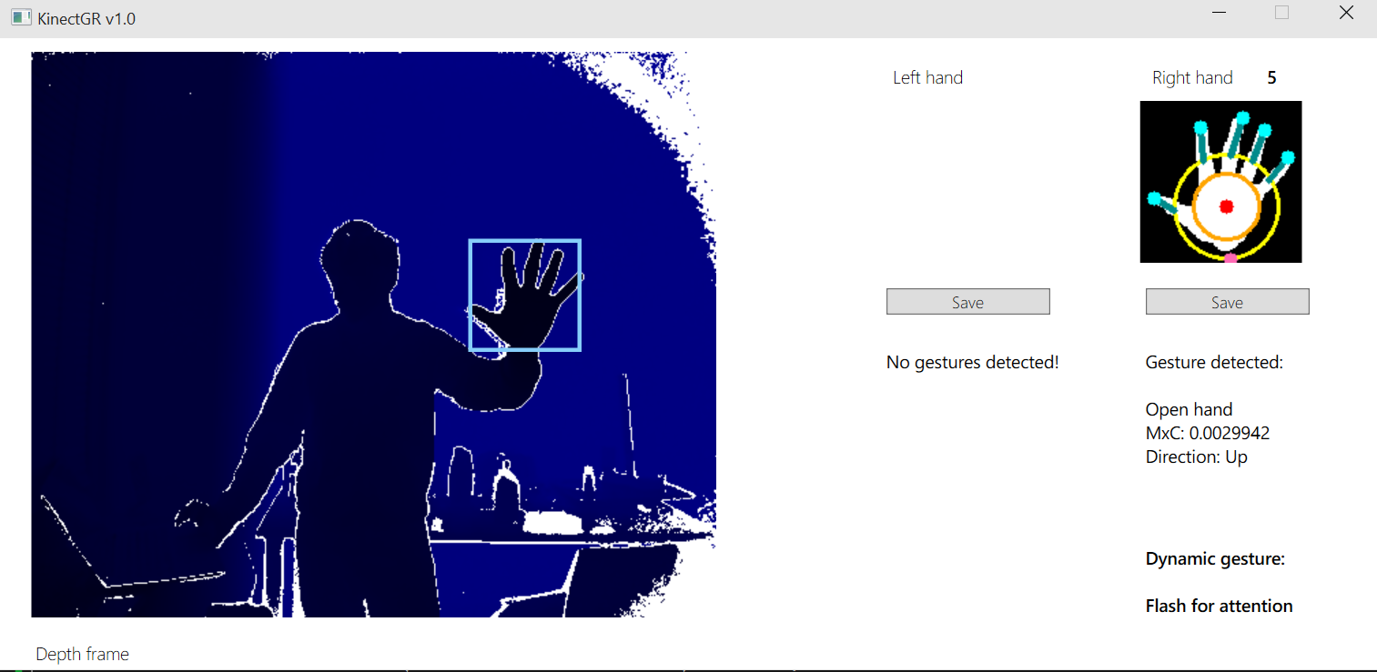
Dynamic gesture recognition
Separate dynamic gestures in two types: Wave and Alternation
Analyze frames stored in the buffer (capped at 35 frames, approximately latest ~2 seconds)
Extract features of interest (e.g. gesture recognized, joint positions, etc.)
Check whether these features satisfy any dynamic gesture

Slide 11
Quick demonstration?

Slide 12
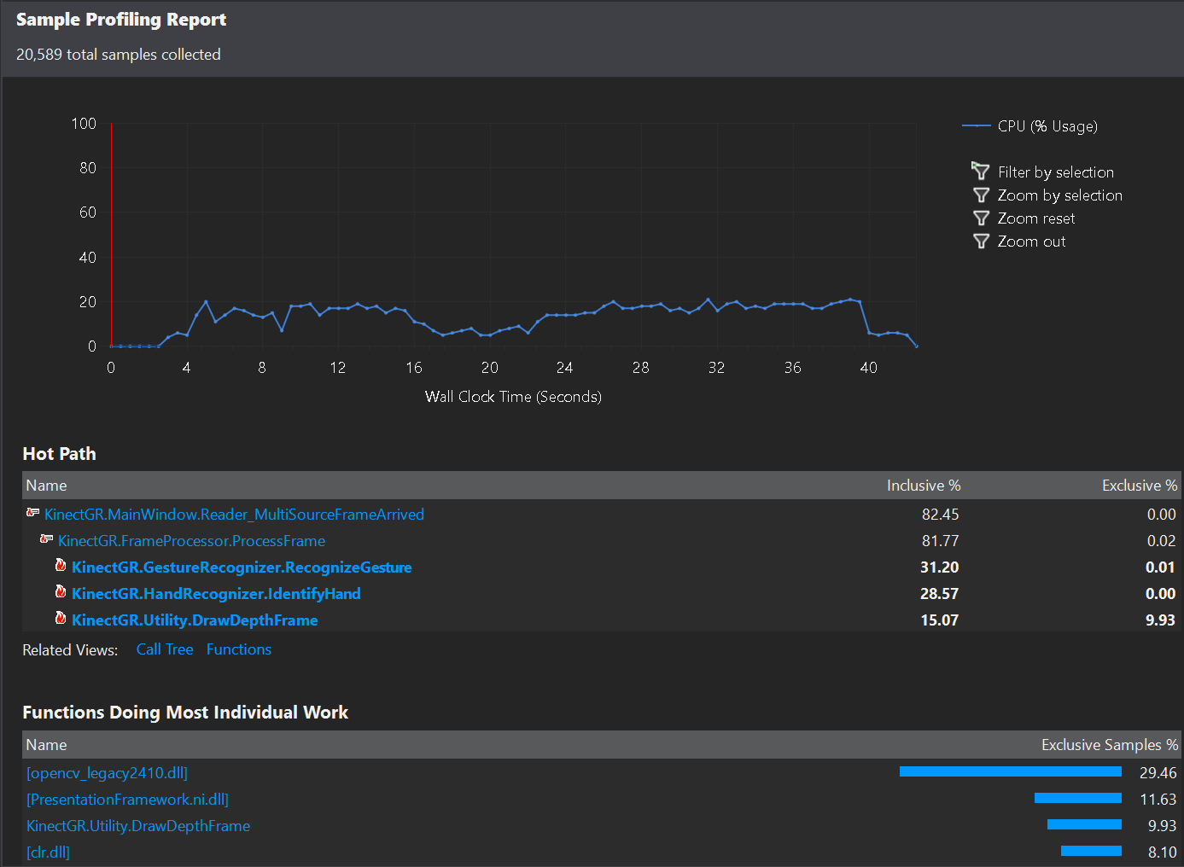
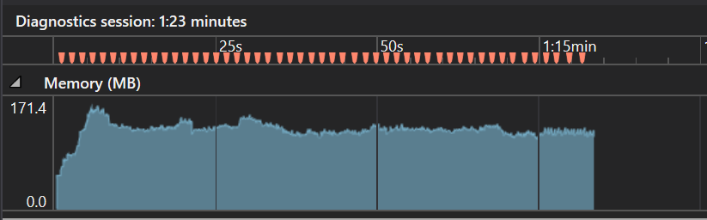
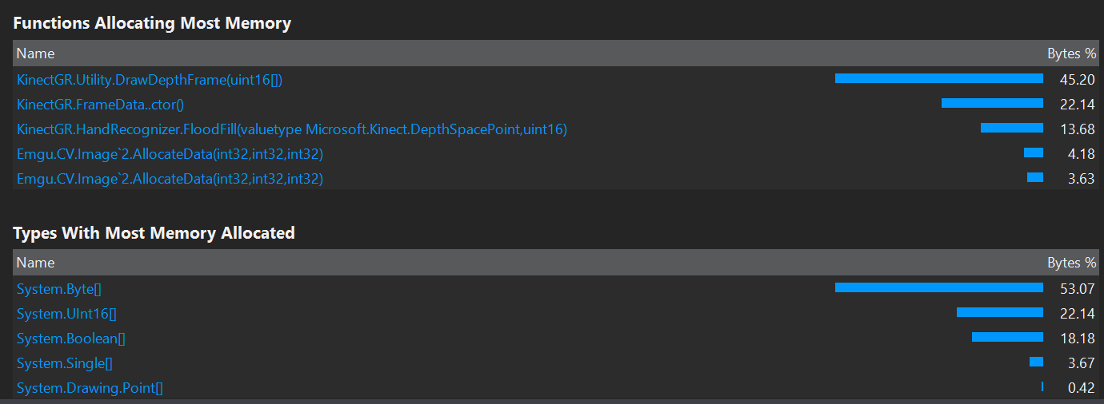
Performance
Notes:
Talk about concurrency (avg 1-2 ms, max 12 ms). Talk about ordering of functions.

Slide 13
Conclusion
Successfully implemented real-time, quite robust gesture recognition system
Can be easily adapted to a custom gesture set
Modular design allows to swap Kinect for another sensor or tweak logic easily
Success rate for recorded gestures reaches 90+%
Source: http://xkcd.com/1403/

Slide 14
Thank you! Any questions?

